Slide 1
Digit recognition analysis for bixby
By: Cesar Contreras

Slide 2

What is bixby
Intelligence assistant for samsung devices like freezers, tv, cell phones, etc ((rival of google home and amazon alexa).
Can be interat by voice, tape, text and pictures.
Direct link to other products and services.

Slide 3
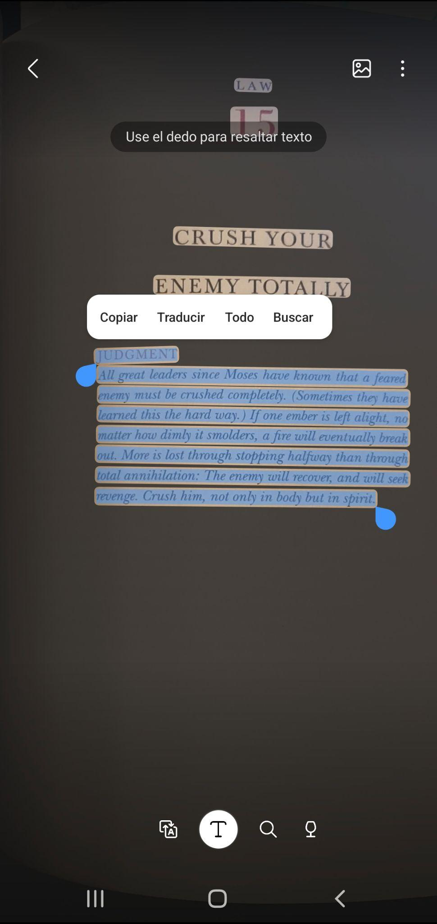
Area of opportunity
Scan handwritten notes.
Create digital notes base on the recognize data
from the image.

Slide 4
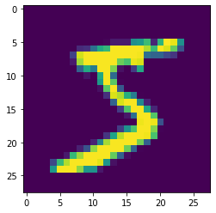
Digital recognition source
Classic dataset of handwritten images for benchmarking classification algorithms.
Numbers
Matrix 28,28

Slide 5
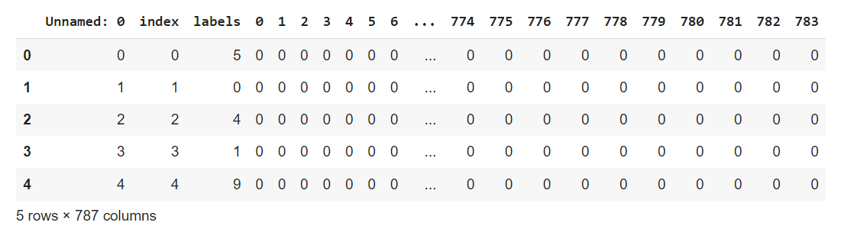
DataFrame

Slide 6
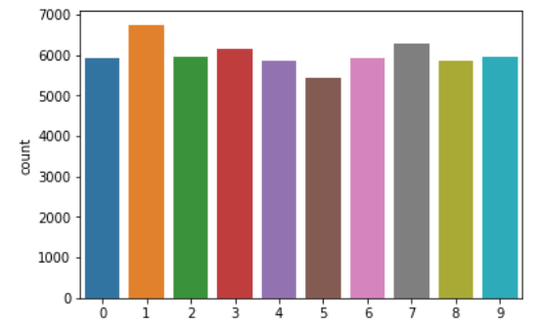
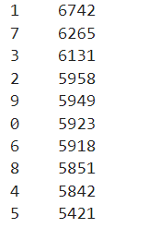
Data exploration

Slide 7
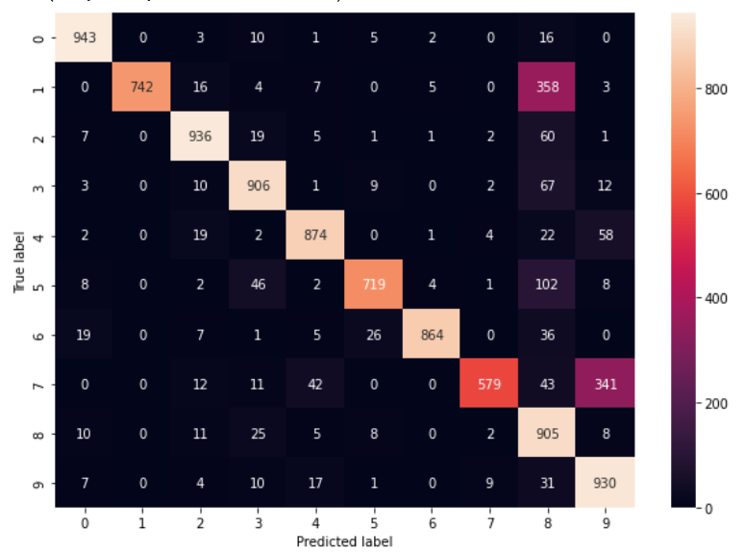
Gauss Bayes Model

Slide 8
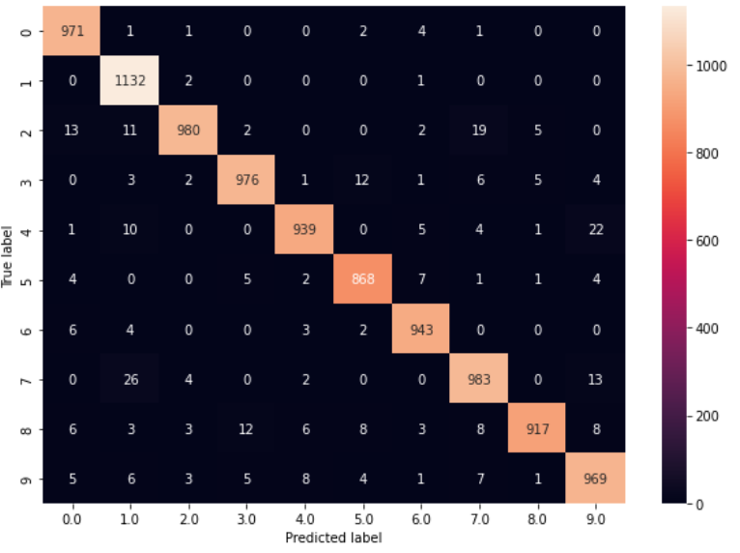
KNN Model

Slide 9
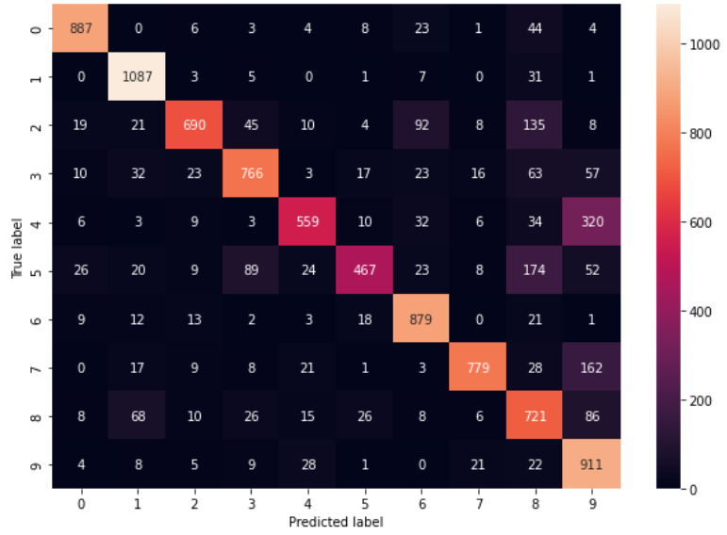
Naive Bayes

Slide 10
Scores
Model | Train | Test
Gauss Bayes | 86.575 | 83.98
Naives Bayes | 77.46 | 76.83
KNN | 100 | 96.78

Slide 11
Link of Github
https://github.com/cesarcontre/Digit-Recognition-

